Slide 1
Financial Accounting
IFRS 5th Edition
Weygandt ● Kimmel
Chapter 5
Accounting for Merchandise Operations
This slide deck contains animations. Please disable animations if they cause issues with your device.
Copyright © John Wiley & Sons, Inc.

Slide 2
Chapter Outline
Learning Objectives
LO 1 Describe merchandising operations and inventory systems.
LO 2 Record purchases under a perpetual inventory system.
LO 3 Record sales under a perpetual inventory system.
LO 4 Apply the steps in the accounting cycle to a merchandising company.
LO 5 Prepare financial statements for a merchandising company.

Slide 3
Learning Objective 1 Describe Merchandising Operations and Inventory Systems.
L O 1
Notes:
We have covered service companies (we had service revenue) in prior chapters. We have multiple types of companies. In this chapter we will cover merchandising companies.

Slide 4
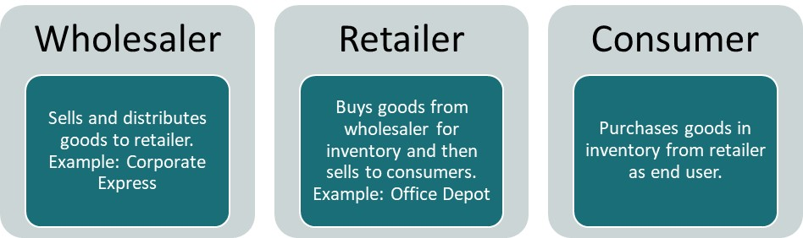
Merchandising Operations and Inventory Systems
Merchandising Companies buy and sell goods.
Examples:
Sam’s club, Walmart, Vanguard (华润万家)
The primary source of revenues is referred to as sales revenue or sales.
L O 1
Notes:
Merchandising companies: buy and sell goods. Merchandising companies, they do not produce goods themselves. Primary source of revenue is sales.
Different types of merchandising companies: wholeseller, retail, and consumer.
Two types: wholeseller → directly sell to retailer, do not sell to consumer. Retailer → sells to consumer.

Slide 5
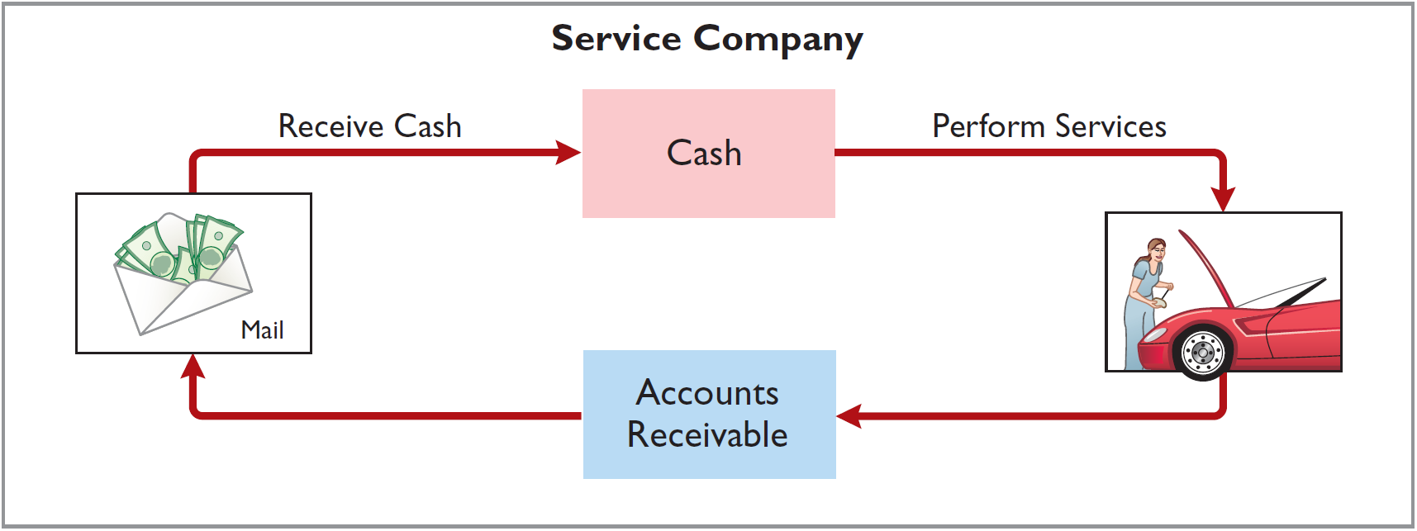
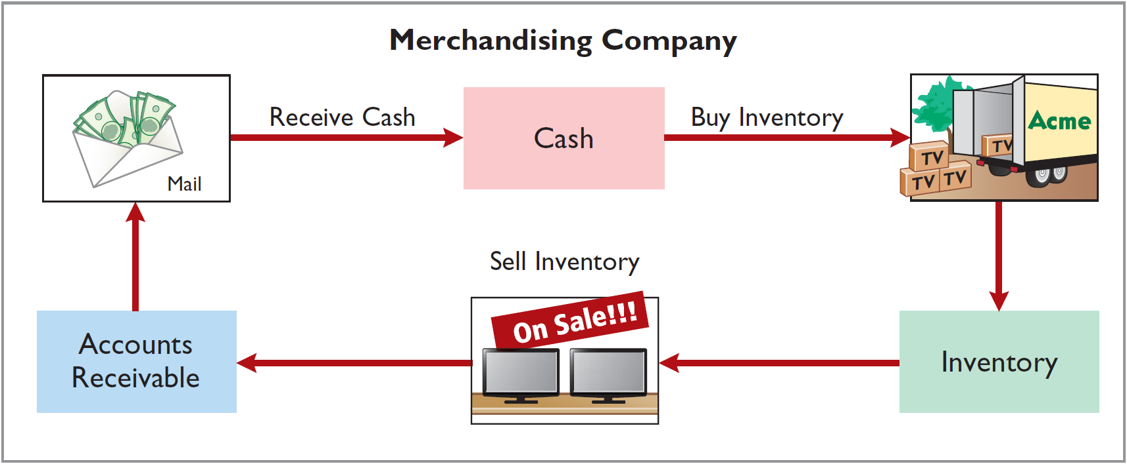
Operating Cycles
Airlines
Sam’s club
Illustration 5.2-3: Operating cycle for a service company (2) and Operating cycle for a merchandising company (3)
L O 1
Notes:
Normally, for service company, when they sell goods, they sell on account. i.e., get A/R.
Merchandising company is slightly different. They have to buy inventory first. Thus, the operating cycle is bit longer.
Inventory → includes items a company intends for sale (after purchase and before sold) to customers in their ordinary business operating cycle. This is company’s economic resource, thus an asset.
Inventory is a current asset because company expects to convert it into cash in the near future.

Slide 6
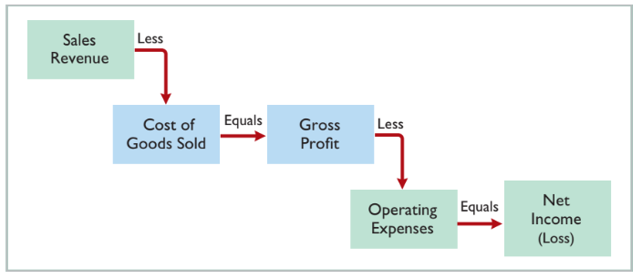
Merchandising Company
Income Measurement
Illustration 5.1: Income measurement process for a merchandising company
L O 1
Notes:
COGS: total cost of merchandise sold during the period. This is expense directly related to revenue recognized from the sale of goods.
Gross Profit = Sales Revenue – COGS. Splitting expense into two parts (1. COGS & 2. Operating Exp). Acct provide information to users. These two expenses have different purpose. COGS related to what I sold. Operating exp → how efficiently I use the resources.
Net Income = Gross Profit – Operating Expenses.

Slide 7
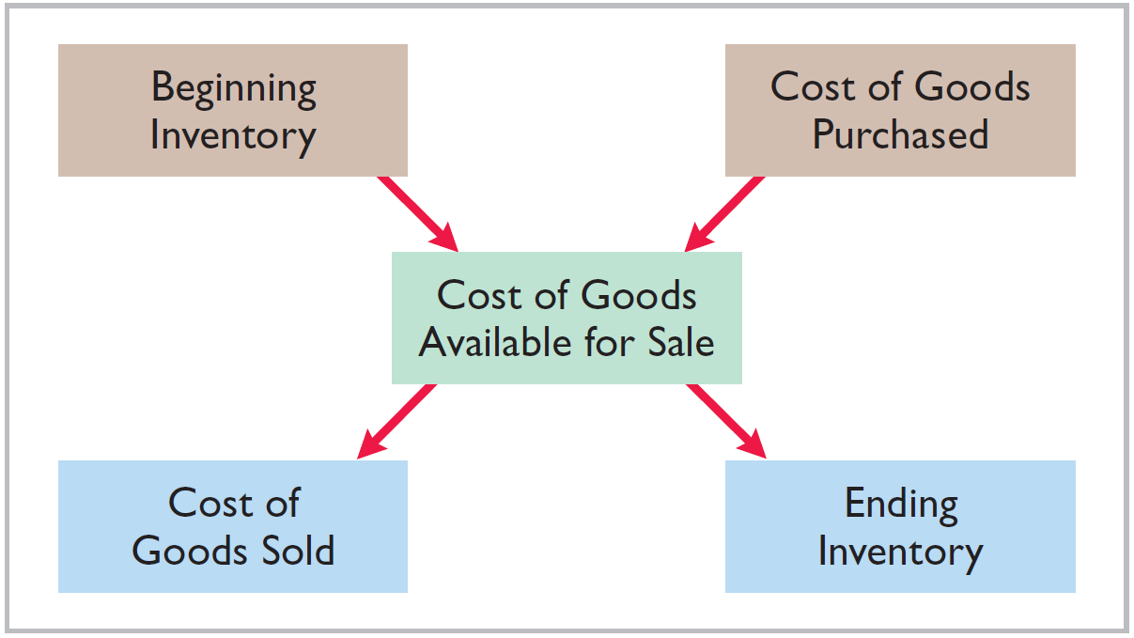
Flow of Costs Overview
Illustration 5.4: Flow of costs
Companies use either a perpetual inventory system or a periodic inventory system to account for inventory.
L O 1

Slide 8
Flow of Inventory
Assume beginning inventory = 200
Purchases = 500
Sell = 300
End Inv = Beg Inv + Pur – Sell
= 200 + 500 – 300 = 400
Notes:
Relationship between inventory and COGS.
Assume beginning inventory is 200.
Company buy 500 inventory. Inventory is 700 after. Selling inventory reduces inventory. If sell 300, then remaining inventory is 400.
End Inv = Beg Inv + Purchase – Sold
Total cost of inventory = 500.
Assume purchase price = $10/unit
If sell, lets assume company sold for $20/unit. COGS → $10* 300
$20 * 300 goes to sales revenue.

Slide 9
Flow of Costs – Perpetual System
Maintains detailed records of the cost of each inventory purchase and sale.
Records continuously show inventory that should be on hand for every item.
Company determines cost of goods sold each time a sale occurs.
L O 1

Slide 10
Flow of Costs – Periodic System
Companies do not keep detailed records of goods on hand throughout the period.
Cost of goods sold determined by count.
Calculation of Cost of Goods Sold:
Beginning inventory | €100,000
Add: Purchases, net | 800,000
Goods available for sale | 900,000
Less: Ending inventory | 125,000
Cost of goods sold | €775,000
L O 1

Slide 11
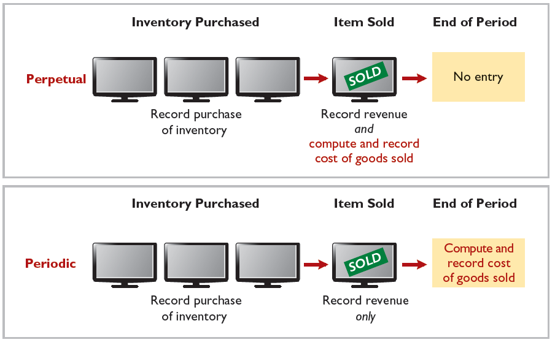
Comparison of Perpetual and Periodic
Illustration 5.5: Comparing perpetual and periodic inventory systems
L O 1

Slide 12
Advantages of Perpetual Systems
Provides better control over inventories than a periodic system.
Shows quantity and cost of inventory that should be on hand at any time.
Allows for companies to check that counts agree with records at any time.
If shortages are discovered, investigation can occur immediately.
L O 1

Slide 13
DO IT! 1: Merchandising Operations and Inventory Systems – Solution
Indicate whether the following statements are true or false. If false, indicate how to correct the statement.
The primary source of revenue for a merchandising company results from performing services for customers. False (service company)
The operating cycle of a service company is usually shorter than that of a merchandising company. True
Sales revenue less cost of goods sold equals gross profit. True
Ending inventory plus the cost of goods purchased equals cost of goods available for sale. False (Beg. Inventory + COG Purchased)
L O 1

Slide 14
Learning Objective 2 Record Purchases Under a Perpetual System.
L O 2

Slide 15
Recording Purchases Under a Perpetual System
Inventory purchases made using cash or credit (on account)
Companies normally record purchases when goods are received from the seller
Purchase invoice should support each credit purchase
L O 2

Slide 16
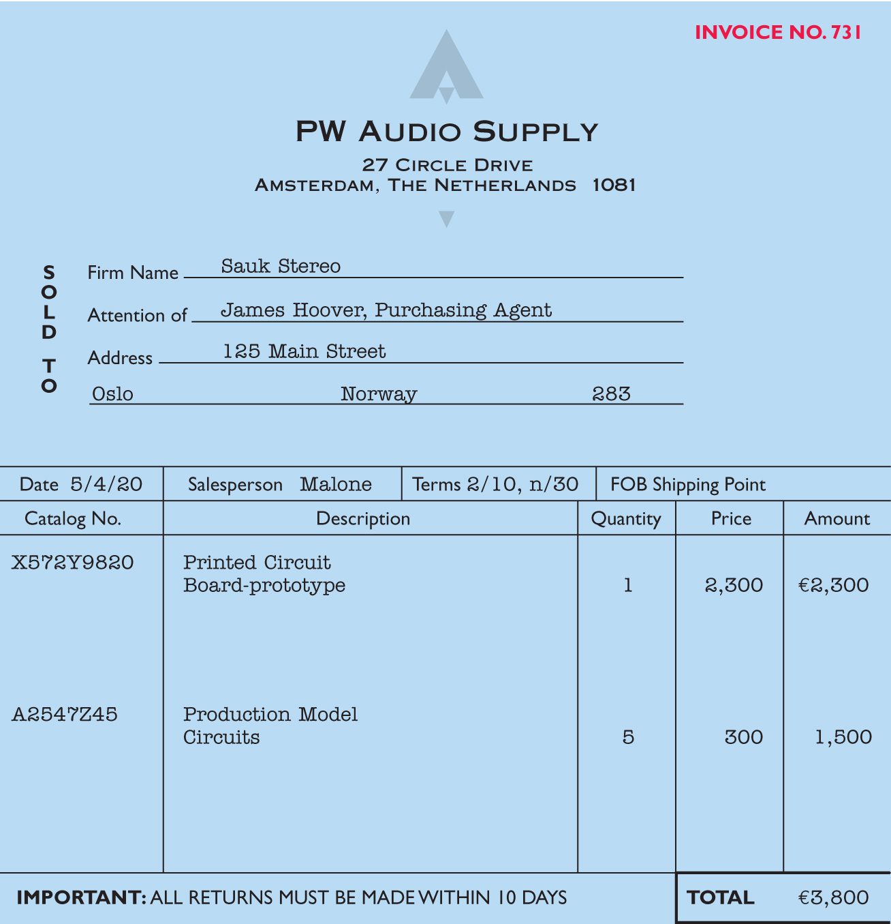
Recording Purchases
Purchase invoice should support each credit purchase.
Illustration 5.6: Sales Invoice used as purchase invoice by Sauk Stereo
L O 2

Slide 17

Record Purchase of Merchandise
Illustration: Sauk Stereo (the buyer) uses as a purchase invoice the sales invoice prepared by PW Audio Supply, Inc. (the seller). Prepare the journal entry for Sauk Stereo for the invoice from PW Audio Supply.
Illustration 5.6: Sales Invoice used as purchase invoice by Sauk Stereo
May 4
Inventory 3,800
Accounts Payable 3,800
L O 2

Slide 18
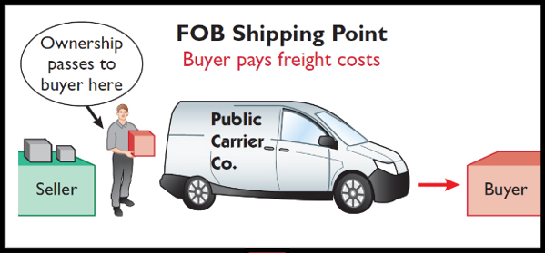
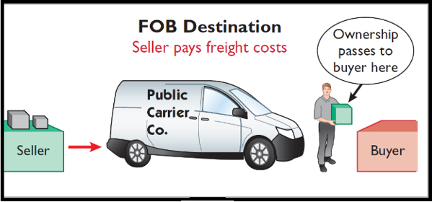
Freight Costs - Ownership
Ownership of the goods passes to the buyer when the public carrier accepts the goods from the seller.
Ownership of the goods remains with the seller until the goods reach the buyer.
The shipping cost is recorded in the inventory for buyers.
Recorded as operating expense for seller.
Illustration 5.7: Shipping terms
L O 2

Slide 19
Freight Costs
Freight terms are expressed as either FOB shipping point or FOB destination.
FOB Shipping point
Buyer pays the freight.
The shipping cost is recorded in the inventory for buyers.
FOB Destination
Seller pays the freight.
Recorded as operating expense for seller.
L O 2

Slide 20
Freight Example
Illustration: Assume upon delivery of the goods on May 6, Sauk Stereo (the buyer) pays Acme Freight €150 for freight charges, the entry on Sauk Stereo’s books is (FOB shipping point ):
May 6
Inventory 150
Cash 150
Assume the freight terms on the invoice on slide number 14 had required PW Audio Supply (the seller) to pay the freight charges, the entry by PW Audio Supply would be (FOB Destination):
May 4
Freight-Out (or Delivery Expense) 150
Cash 150
L O 2

Slide 21
Purchase Returns and Allowances
Purchaser may be dissatisfied because goods are damaged or defective, of inferior quality, or do not meet specifications.
Purchase Return
Return goods for credit if the sale was made on credit, or for a cash refund if the purchase was for cash.
Purchase Allowance
May choose to keep the merchandise if the seller will grant a reduction of the purchase price.
L O 2

Slide 22
Purchase Return Example
Illustration: Assume Sauk Stereo returned goods (purchased on credit) costing €300 to PW Audio Supply on May 8.
The following entry would be required to record the return:
May 8
Accounts Payable 300
Inventory 300
L O 2

Slide 23
Purchase Review Question
In a perpetual inventory system, a return of defective merchandise by a purchaser is recorded by crediting:
Purchases
Purchase Returns
Purchase Allowance
Inventory
L O 2

Slide 24
Purchase – Solution
In a perpetual inventory system, a return of defective merchandise by a purchaser is recorded by crediting:
Purchases
Purchase Returns
Purchase Allowance
Inventory (Correct)
L O 2

Slide 25
Purchase Discounts
Credit terms may permit buyer to claim a cash discount for prompt payment.
Advantages:
Purchaser saves money
Seller shortens the operating cycle by converting the accounts receivable into cash earlier
Example: Credit terms may read 2/10, n/30.
L O 2

Slide 26
Examples of Credit Terms
2/10, n/30
2% discount if paid within 10 days, otherwise net amount due within 30 days.
1/10 EOM
1% discount if paid within first 10 days of next month.
n/10 EOM
Net amount due within the first 10 days of the next month.
L O 2

Slide 27
Purchase Discounts Example
Illustration: Assume Sauk Stereo pays the balance due of €3,500 (gross invoice price of €3,800 less purchase returns and allowances of €300) on May 14, the last day of the discount period. Assuming 2% discount. Prepare the journal entry Sauk Stereo makes on May 14 to record the payment.
May 14
Accounts Payable 3,500
Cash 3,430
Inventory 70
(Discount = €3,500 × 2% = €70)
L O 2
Notes:
Crediting Inventory directly reduces the cost of the Inventory on hand, reflecting the fact that the company effectively paid less for the goods.
Reduce inventory cost due to discount.
Alternatively, we can also credit "Purchase Discounts" to track such discounts, which later impacts the cost of goods sold when inventory is sold.

Slide 28
Purchase Discount Example – No Discount
Illustration: If Sauk Stereo failed to take the discount, and instead made full payment of €3,500 on June 3, the journal entry would be:
June 3
Accounts Payable 3,500
Cash 3,500
L O 2

Slide 29
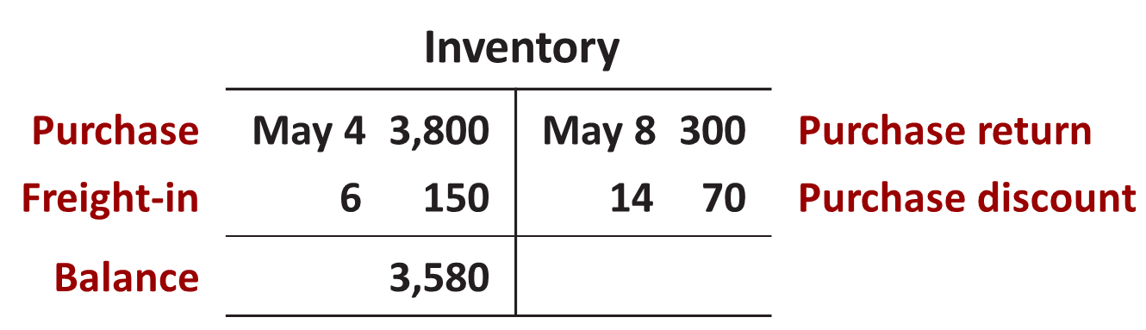
Summary of Purchasing Transactions
The following T-account provides a summary of the previous transactions on Inventory.
L O 2

Slide 30
DO IT! 2: Purchase Transactions
On September 5, Zhū Company buys merchandise on account from Gāo Company. The purchase price of the goods paid by Zhū is ¥15,000, and the cost to Gāo Company was ¥8,000. On September 8, Zhū returns defective goods with a selling price of ¥2,000. Record the transactions on the books of Zhū Company.
L O 2

Slide 31
DO IT! 2: Purchase Transactions – Solution
Sept. 5
Inventory 15,000
Accounts Payable 15,000
Sept. 8
Accounts Payable
Inventory
2,000
2,000
L O 2

Slide 32
Learning Objective 3 Record Sales Under a Perpetual Inventory System.
L O 3

Slide 33
Recording Sales - Perpetual System
Sales may be made on credit or for cash.
Sales revenue, like service revenue, is recorded when the performance obligation is satisfied.
Performance obligation is satisfied when goods are transferred from seller to buyer.
Sales invoice should support each credit sale.
L O 3

Slide 34
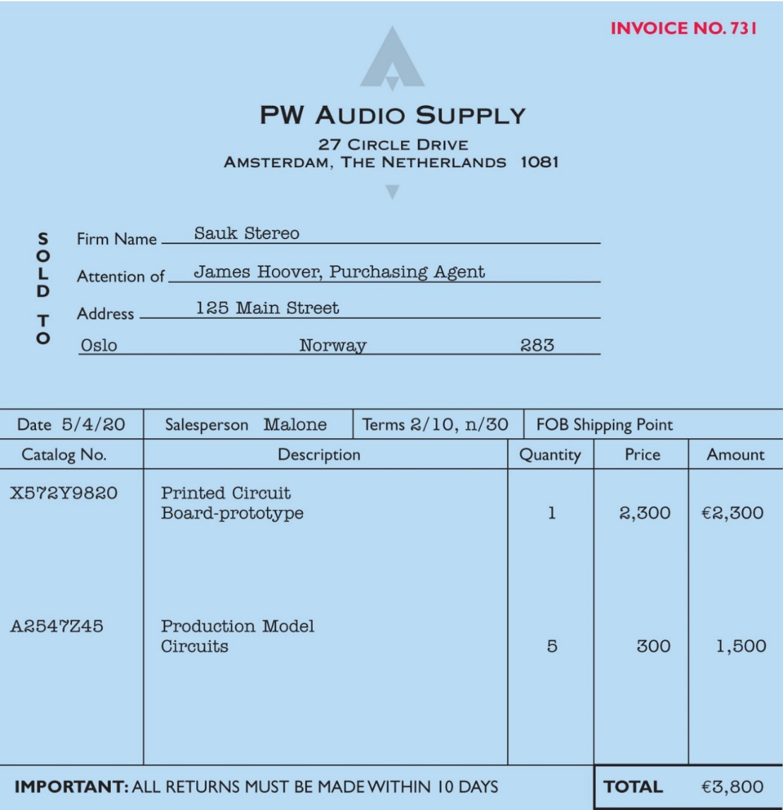
Sales invoice should support each credit sale
Illustration 5.6: Sales Invoice used as purchase invoice by Sauk Stereo
L O 3

Slide 35
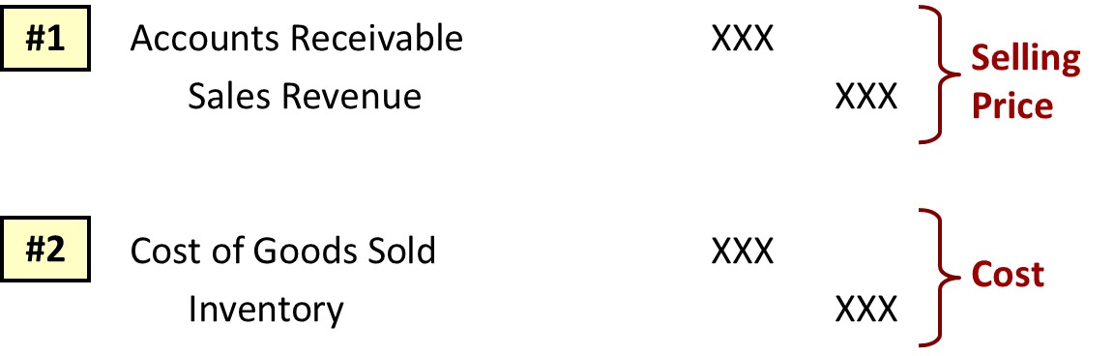
Entries to Record Sales
Journal Entries to Record a Sale
L O 3

Slide 36
Recording Sales Example
Illustration: PW Audio Supply records the sale of €3,800 on May 4 to Sauk Stereo on account as follows (assume the merchandise cost PW Audio Supply €2,400).
May 4
Accounts Receivable 3,800
Sales Revenue 3,800
4
Cost of Goods Sold 2,400
Inventory 2,400
L O 3

Slide 37
Sales Returns and Allowances
Contra revenue account (debit) to Sales Revenue
Sales not reduced (debited) because:
Important to keep track of sales returns and allowances as a percentage of sales.
Important because excessive returns and allowances may suggest problems.
Could distort comparisons between total sales in different accounting periods.
L O 3
Notes:
Contra account → want to preserve more information.

Slide 38
Sales Returns and Allowances Example
Illustration: Prepare the entry PW Audio Supply would make to record the credit for returned goods that had a €300 selling price (assume a €140 cost). Assume the goods were not defective.
May 8
Sales Returns and Allowance 300
Accounts Receivable 300
8
Inventory 140
Cost of Goods Sold 140
L O 3

Slide 39
Sales Returns – Defective Example
Illustration: Assume the returned goods were defective and had a scrap value of €50, PW Audio would make the following entries:
May 8
Sales Returns and Allowance 300
Accounts Receivable 300
8
Inventory 50
Cost of Goods Sold 50
L O 3
Notes:
Recovered inventory → only recover 50, because defective and scrap value is 50.

Slide 40
Sales Returns and Allowances Review Question
The cost of goods sold is determined and recorded each time a sale occurs in:
periodic inventory system only.
a perpetual inventory system only.
both a periodic and perpetual inventory system.
neither a periodic nor perpetual inventory system.
L O 3

Slide 41
Sales Returns and Allowances – Solution
The cost of goods sold is determined and recorded each time a sale occurs in:
periodic inventory system only.
a perpetual inventory system only. (Correct)
both a periodic and perpetual inventory system.
neither a periodic nor perpetual inventory system.
L O 3

Slide 42
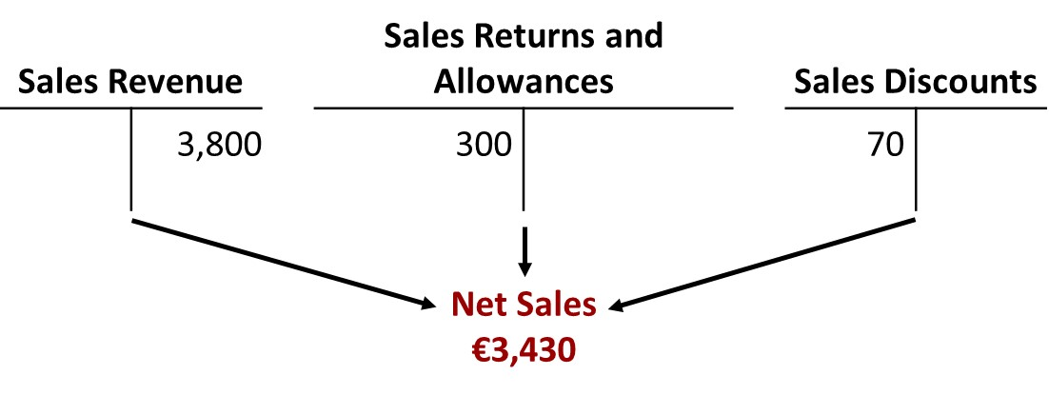
Sales Discounts
Offered to customers to promote prompt payment of balance due
Contra-revenue account (debit) to Sales Revenue
L O 3

Slide 43
Sales Discounts Example
Illustration: Assume Sauk Stereo pays the balance due of €3,500 (gross invoice price of €3,800 less purchase returns and allowances of €300) on May 14, the last day of the discount period. Prepare the journal entry PW Audio Supply makes to record the receipt on May 14.
May 14
Cash 3,430
Sales Discounts 70*
Accounts Receivable 3,500
*[(€3,800 − €300) × 2%]
L O 3
Notes:
PW Audio:
Reduce AR 3500 → customer paid balance.
The company was given discount of 3430. Sales Discount is debited at 70.

Slide 44
DO IT! 3: Sales Transactions
On September 5, Zhū Company buys merchandise on account from Gāo Company. The selling price of the goods is ¥15,000, and the cost to Gāo Company was ¥8,000. On September 8, Zhū returns defective goods with a selling price of ¥2,000 and a net realizable value of ¥300. Record the transactions on the books of Gāo Company.
L O 3

Slide 45
DO IT! 3: Sales Transactions – Solution
Sept. 5
Accounts Receivable 15,000
Sales Revenue 15,000
5
Cost of Goods Sold 8,000
Inventory 8,000
Sept. 8
Sales Returns and Allowances 2,000
Accounts Receivable 2,000
Sept. 8
Inventory 300
Cost of Goods Sold 300
L O 3
Notes:
Sales rev & COGS for 15000 & 8000
Sep 8… returns
Buying company returns 2000 good with fair value 300.
Reverse the revenue & reverse COGS.
Revenue reversal is debit sales return → 2000; Reduce AR
Recovered part of inventory and reduce previously recorded COGS by 300.

Slide 46
Learning Objective 4 Apply the Steps in the Accounting Cycle to a Merchandising Company.
L O 4

Slide 47
Adjusting Entries
Generally same as those of a service company.
Merchandising company makes additional adjustment so that records agree with actual inventory on hand.
Involves adjusting Inventory and Cost of Goods Sold.
L O 4

Slide 48
Adjusting Entries Example
Illustration: Suppose that PW Audio Supply has an unadjusted balance of €40,500 in Inventory. Through a physical count, PW Audio Supply determines that its actual merchandise inventory at December 31 is €40,000. The company would make an adjusting entry as follows.
Dec. 31
Cost of Goods Sold 500
Inventory (€40,500 − €40,000) 500
L O 4

Slide 49
Closing Entries
Dec. 31 | Sales Revenue | 480,000
 | Income Summary |  | 480,000
 | (Close credit balance accounts)
31 | Income Summary | 450,000
 | Cost of Goods Sold |  | 316,000
 | Salaries and Wages Expense |  | 64,000
 | Utilities Expense |  | 17,000
 | Advertising Expense |  | 16,000
 | Sales Returns and Allowances |  | 12,000
 | Sales Discounts |  | 8,000
 | Depreciation Expense |  | 8,000
 | Freight-Out |  | 7,000
 | Insurance Expense |  | 2,000
 | (Close debit balance accounts)
L O 4

Slide 50
Closing Entries Continued
Dec. 31 | Income Summary | 30,000
 | Retained Earnings |  | 30,000
 | (To close net income to retained earnings)
31 | Retained Earnings | 15,000
 | Dividends |  | 15,000
 | (To close dividends to retained earnings)
L O 4

Slide 51
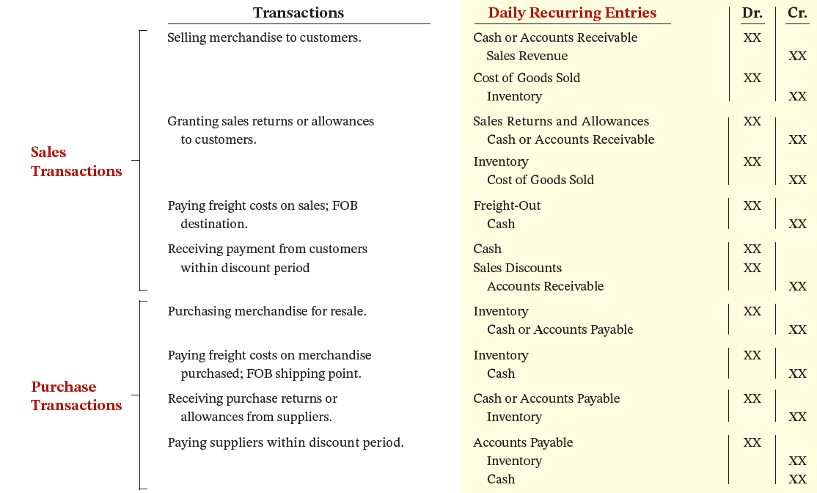
Summary of Merchandising Entries
Illustration 5.8 (Partial): Daily recurring and adjusting and closing entries
L O 4

Slide 52
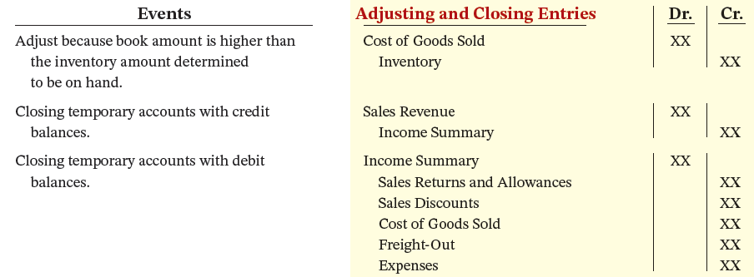
Summary of Merchandising Entries - Events
Illustration 5.8 (Partial): Daily recurring and adjusting and closing entries
L O 4

Slide 53
DO IT! 4: Closing Entries
The trial balance of Celine’s Sports Wear Shop at December 31 shows Inventory €25,000, Sales Revenue €162,400, Sales Returns and Allowances €4,800, Sales Discounts €3,600, Cost of Goods Sold €110,000, Rent Revenue €6,000, Freight-Out €1,800, Rent Expense €8,800, and Salaries and Wages Expense €22,000. Prepare the closing entries for the above accounts.
L O 4

Slide 54
DO IT! 4: Closing Entries – Solution
Dec. 31
Sales Revenue 162,400
Rent Revenue 6,000
Income Summary 168,400
Dec. 31
Income Summary 151,000
Cost of Goods Sold 110,000
Sales Returns and Allowances 4,800
Sales Discounts 3,600
Freight-Out 1,800
Rent Expense 8,800
Salaries and Wages Expense 22,000
L O 4

Slide 55
Learning Objective 5 Prepare Financial Statements for a Merchandising Company.
L O 5

Slide 56
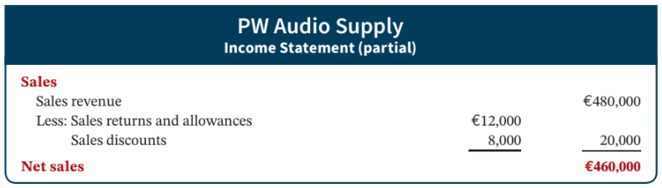
Income Statement
Primary source of information for evaluating a company’s performance.
Format is designed to differentiate between various sources of income and expense.
Illustration 5.9: Computation of net sales
L O 5

Slide 57
Income Statement Example
Gross Profit
On the basis of the sales data for PW Audio Supply (net sales of €460,000) and cost of goods sold under the perpetual inventory system (assume €316,000), PW Audio Supply’s gross profit is €144,000, computed as shown.
Net Sales | €460,000
Cost of goods sold | 316,000
Gross profit | €144,000
Illustration 5.10: Computation of gross profit
L O 5

Slide 58
Gross Profit Rate (Gross margin rate)
We also can express a company’s gross profit as a percentage, called the gross profit rate.
Analysts generally consider the gross profit rate to be more useful than the gross profit amount.
The rate expresses a more meaningful (qualitative) relationship between net sales and gross profit.
Gross Profit | ÷ | Net Sales | = | Gross Profit Rate
€144,000 | ÷ | €460,000 | = | 31.3%
Illustration 5.11: Gross profit rate formula and computation
L O 5

Slide 59





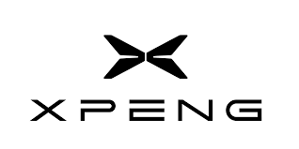
Gross Profit Rate (Gross margin)
Source: Ychat
L O 5

Slide 60

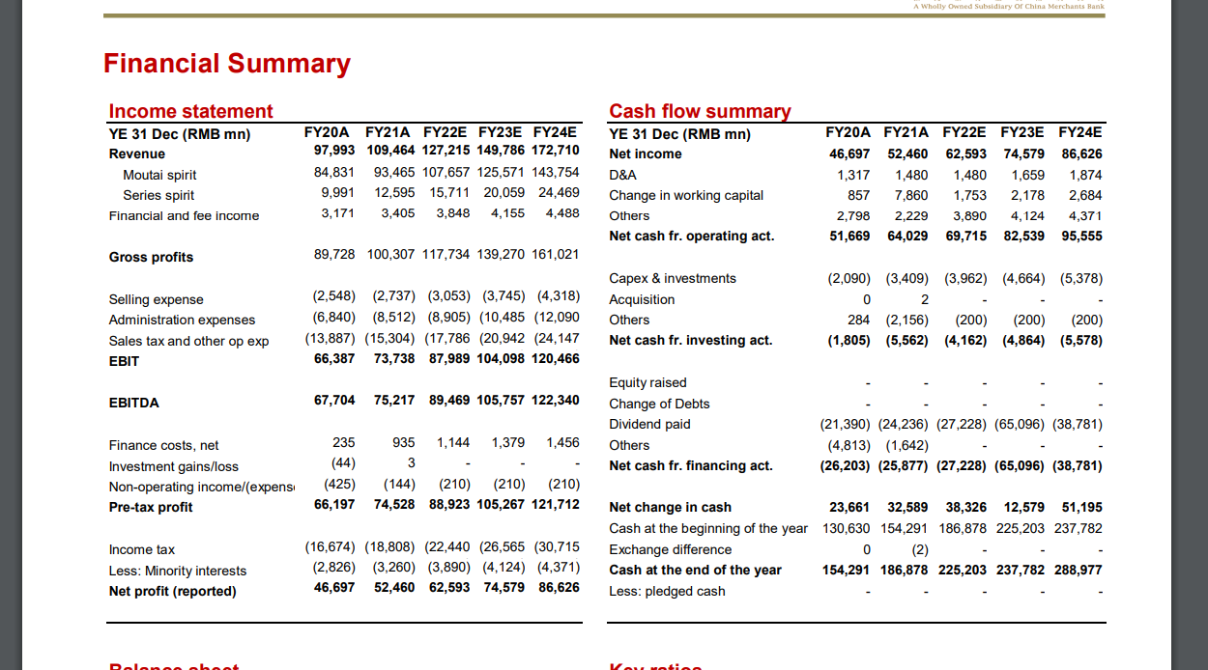
Gross Profit Rate (Gross margin)
117.7/127.2= about 93% !!!
L O 5

Slide 61
Why Maotai has high gross margin?
Revenue side: it is able to sell their product at a large premium price
Cost side: the inventory cost is low i.e., Maotai does not have to buy much inventories. The raw material is just water and yeast.

Slide 62
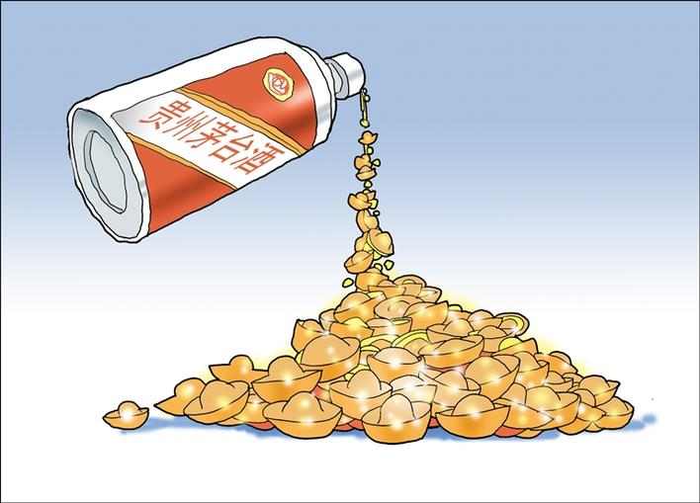

Slide 63
Operating Expenses
Incurred in the process of earning sales revenue. Operating expense for PW Audio Supply include the following.
Operating expenses
Salaries and wages expense | € 64,000
Utilities expense | 17,000
Advertising expense | 16,000
Depreciation expense | 8,000
Freight-out | 7,000
Insurance expense | 2,000
Total operating expenses | €114,000
Illustration 5.12: Operating expenses
L O 5

Slide 64
Other Income and Expense
Various revenues and gains and expenses and losses that are unrelated to the company’s main line of operations.
Other Income
Interest revenue from notes receivable and marketable securities. Dividend revenue from investments in ordinary shares. Rent revenue from subleasing a portion of the store. Gain from the sale of property, plant, and equipment.
Other Expense
Casualty losses from such causes as vandalism and accidents. Loss from the sale or abandonment of property, plant, and equipment. Loss from strikes by employees and suppliers.
Illustration 5.13: Examples of other income and expense
L O 5

Slide 65
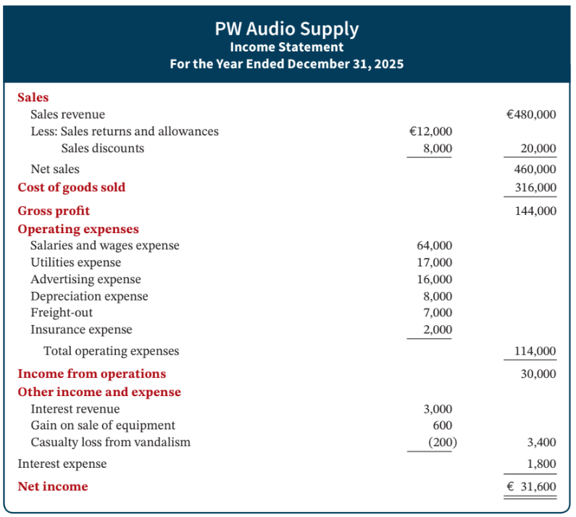
Income Statement – PW Audio Supply
Key Items:
Sales
Gross Profit
Operating Expenses
Other Income and Expense
Net Income
Illustration 5.14: Income statement
L O 5

Slide 66
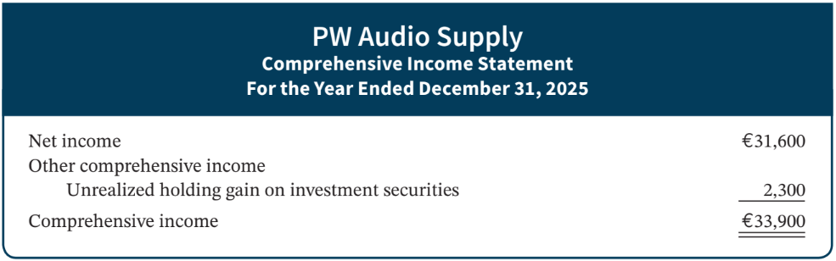
Comprehensive Income Statement
(not required for this class, the only thing you need to know is Comprehensive income statement is not Income statement)
Presents items not included in the determination of net income.
L O 5

Slide 67
DO IT! 5: Financial Statement Classification
Indicate in which financial statement and under what classification each of the following would be reported (Income statement – IS; statement of financial position – SFP; retained earnings statement – RES)
Financial Statement
Account
Classification
Accounts payable
SFP
Current liabilities
Accounts receivable
SFP
Current assets
Accumulated Depreciation-Buildings
SFP
Property, plant, and equipment
Accumulated Depreciation-Equipment
SFP
Property, plant, and equipment
Advertising Expense
IS
Operating expenses
Buildings
SFP
Property, plant, and equipment
Cash
SFP
Current assets
Depreciation Expense
IS
Operating expenses
Dividends
RES Deduction section
L O 5

Slide 68
DO IT! 5: Solution – Part 1
Indicate in which financial statement and under what classification each of the following would be reported.
Financial Statement
Account
Classification
Equipment
SFP
Property, plant, and equipment
Freight-Out
IS
Operating expenses
Gain on Disposal of Plant Assets
IS
Other income and expense
Insurance Expense
IS
Operating expenses
Interest Expense
IS
Interest expense
Interest Payable
SFP
Current liabilities
Inventory
SFP
Current assets
Land
SFP
Property, plant, and equipment
Notes Payable (due in 3 years)
SFP Non-current liabilities
L O 5

Slide 69
DO IT! 5: Solution – Part 2
Indicate in which financial statement and under what classification each of the following would be reported.
Financial Statement
Account
Classification
Property Taxes Payable
SFP
Current liabilities
Salaries and Wages Expense
IS
Operating expenses
Salaries and Wages Payable
SFP
Current liabilities
Sales Returns and Allowances
IS
Sales
Sales Revenue
IS
Sales
Share Capital—Ordinary
SFP
Equity
Utilities Expense
IS
Operating expenses
L O 5

